Slide 1
CREATING AN APP SERVICE CONNECTION TO AZURE SQL DATABASE WITH AZURE MANAGED IDENTITY.
CLOUD SECURITY - GROUP 5
DONNA
DEBORAH
DUMEBI
CYNTHIA
COLLINS

Slide 2
PROJECT OVERVIEW
In this project, one will learn how to connect an App service to an Azure SQL Database using managed identities.
Azure was chosen because it offers a stable, reliable base and makes it simple to move data between on-premises and public clouds.
To address the issue of credentials management in Azure SQL Database, this project will provide a brief overview of App Service, SQL Database, Managed identity, and how these Azure services work together.
It is customary to include both the username and password in the connection string to the Azure SQL database.

Slide 3
PROJECT OVERVIEW
Even if users keep these passwords in KeyVault, they still need to be changed periodically, and they could fall into the wrong hands.
As an illustration, if developers maintain the password on their development machines, this creates a vulnerability that an attacker can take advantage of.
The managed identity solution offered by Azure helps to lessen the likelihood of such incidents.
Microsoft Azure's managed identities feature enables supported Azure resources to identify or authorize themselves.
The claim is that copying of secrets, including database passwords, and source control checks are not required.

Slide 4
APP SERVICE
In Azure, App Service offers a self-patching, highly scalable web hosting service.
Additionally, it gives your app access to a managed identity, a complete solution for safeguarding access to Azure SQL Database and other Azure services.
By removing sensitive information from your app, such as credentials in the connection strings, managed identities in App Service increase the security of your app.
One can create and host web applications, mobile back ends, and RESTful APIs using Azure App Service without having to worry about maintaining infrastructure.
It supports both Windows and Linux, provides auto-scaling and high availability, and enables automated deployments from GitHub, Azure DevOps, or any Git repository.

Slide 5
APP SERVICE
Its DevOps features, such as continuous deployment via Azure DevOps, GitHub, Docker Hub, and other sources, package management, staging environments, custom domains, and TLS/SSL certificates, are also available for use.
App Service enhances your application's functionality by bringing Microsoft Azure's security, load balancing, autoscaling, and automated administration features.
Azure App Service is a platform as a service (PaaS) offering for developers that is fully managed.
Various frameworks and languages, connections to SaaS platforms and on-premises data, DevOps optimization, global scalability with high availability safety and conformity, Application templates, API features, mobile functionality, and serverless code are just a few of the key features of App Service.

Slide 6
MANAGED IDENTITY
Managed identities, initially Managed Service Identity (MSI), is a service offered by Azure for Azure resources that essentially does away with the need for developers to manage credentials.
It is noted as an identity service on the Azure portal.
When connecting to resources that support Azure Active Directory (Azure AD) authentication, applications can use Managed Identities, an Azure Active Directory capability, to manage identities automatically.
A special-purpose service principal that can only be used with Azure resources is referred to as managed identity.
It connects a resource in Azure to a service principal object. According to the Role Based Access Control protocol, a service principal is a program in Azure Active Directory with authorization to authenticate and access Azure resources or resource groups.

Slide 7
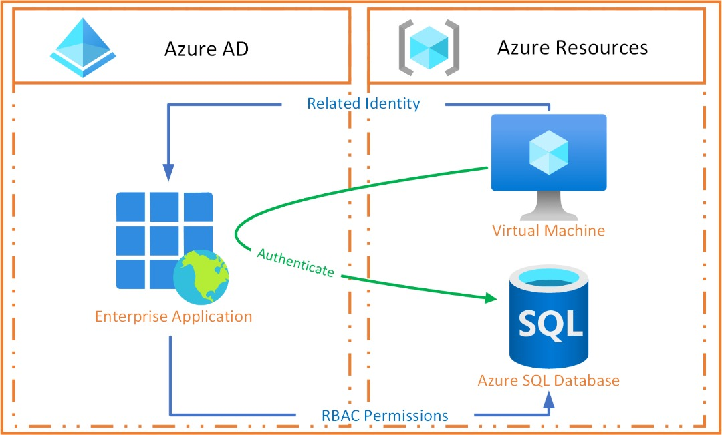
MANAGED IDENTITY

Slide 8
MANAGED IDENTITY
The primary types of managed identities are system-assigned and user-assigned identities.
System-assigned handles the identity lifecycle automatically because managed identities are established as a part of the Azure resource and share its lifecycle.
User-assigned managed identities, in contrast, are separate from the Azure resources that are produced, necessitating administrative control of the lifecycle of the created resources.
Using managed identities provides a few major benefits, such as not having to manage credentials as they aren't even visible to the user, being able to log in to any resource that supports Azure AD authentication, including the user's applications, and being cost-free to use.

Slide 9
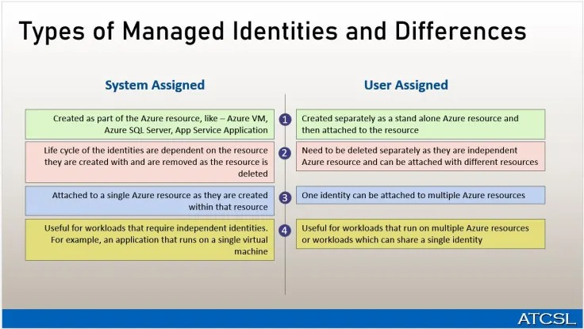
MANAGED IDENTITY

Slide 10
AZURE SQL DATABASE
Modern cloud applications are made possible by Azure SQL Database, a managed database service that uses serverless computing and is intelligent.
It is a part of Azure SQL, a collection of managed, secure, and intelligent products that make use of the SQL Server database engine in the Azure cloud.
The majority of database management operations, including updating, patching, backups, and monitoring, are handled automatically by the fully managed platform as a service (PaaS) database engine known as Azure SQL Database.
Azure SQL Database always makes use of a patched operating system and the most recent stable version of the SQL Server database engine.
Users can utilize Azure SQL Database to create a highly available and high-performance data storage layer for the apps and solutions in Azure.
Azure SQL Database offers a single database and an elastic pool for database deployment.

Slide 11
AZURE SQL DATABASE
Single database is a standalone, continuously updated database.
This option is picked if one has modern cloud apps and microservices that need a single reliable data source.
A single database is analogous to a limited database in the SQL Server database engine.
An elastic pool is a collection of distinct databases that share a common set of resources, such as CPU or memory.
Individual databases can be moved in and out using an elastic pool.
Elastic pools and standalone databases can be combined, and their service levels can be adjusted to meet different demands.
Users may also integrate SQL Database with other Azure services to meet certain app design requirements, maximize resource and financial efficiency, and create new business opportunities.

Slide 12
CREATING AN APP SERVICE CONNECTION TO AZURE SQL DATABASE WITH AZURE MANAGED IDENTITY.
Before managed identities may connect to Azure SQL Database, a user must first enable Azure Active Directory (AD) authentication and create the managed users in the database.
When establishing Azure AD authentication for your Azure SQL Server, ensure that the database server has an Azure AD administrator setup.
The primary function of the Azure AD administrator is to design database-specific roles.
Create a managed identity next. Setup a confined user to enable database authentication. The confined user's name must coincide with the app's name when using system-assigned identities.
The contained user must share the same name as the managed identity when utilizing User assigned identity. Whether you utilize a user- or system-assigned identity has no bearing on anything.
If a user decides to use one, make sure that type of managed identity is set up for the necessary app service. If not, create one, whether it be user- or system-assigned.

Slide 13
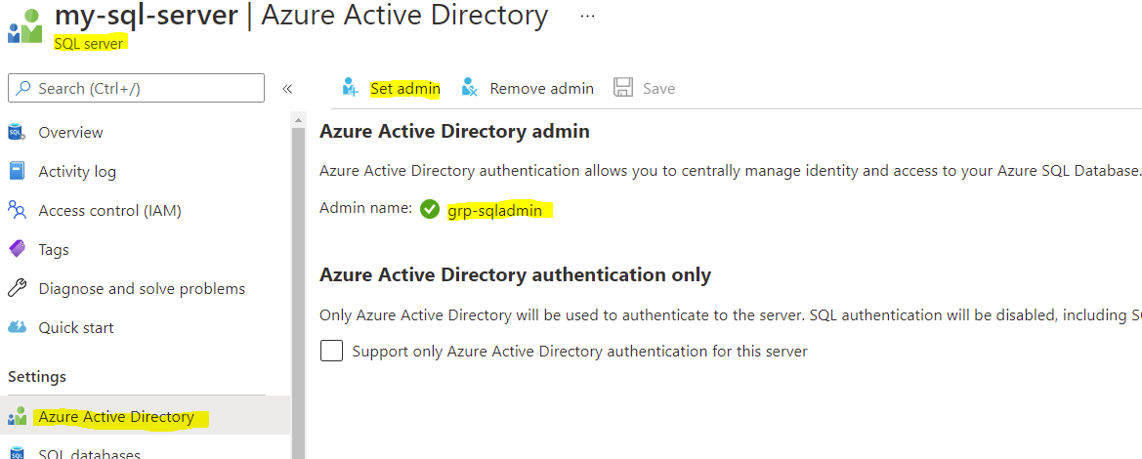
Enable Azure Active Directory (AD) Authentication

Slide 14
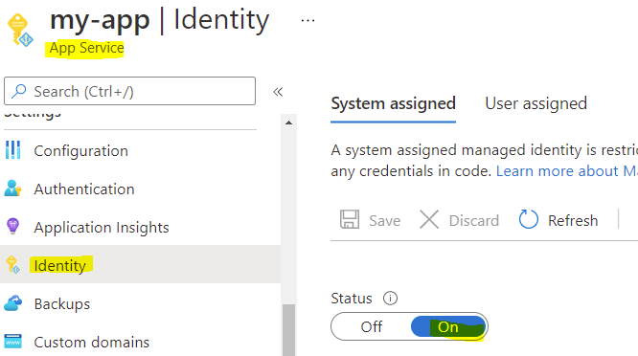
Create Managed Identity

Slide 15
CREATING AN APP SERVICE CONNECTION TO AZURE SQL DATABASE WITH AZURE MANAGED IDENTITY.
Once an identity has been provided to that app service, run the SQL listed below to create a contained user with a few roles that can read and write to the database.
create user [my-app-service] from external provider;
alter role db_datareader add member [my-app-service];
alter role db_datawriter add member [my-app-service];
create user [my-app-service/slots/staging] from external provider;
alter role db_datareader add member [my-app-service/slots/staging];
alter role db_datawriter add member [my-app-service/slots/staging];

Slide 16
CREATING AN APP SERVICE CONNECTION TO AZURE SQL DATABASE WITH AZURE MANAGED IDENTITY.
Change the SQL Connection so that managed identities are used after creating the SQL users and assigning them to read and write permissions.
After that, modify your application such that it uses managed identities for authentication and authorization.
To begin using an Azure App Service managed identity, create a new project and import a few components, such as the Azure SDK for authentication, "Microsoft.Azure.Services.AppAuthentication."
mkdir PLSQLManagedIdentity
cd PLSQLManagedIdentity
dotnet new mvc
dotnet add package Microsoft.Azure.Services.AppAuthentication
dotnet add package Microsoft.Data.SqlClient

Slide 17
CREATING AN APP SERVICE CONNECTION TO AZURE SQL DATABASE WITH AZURE MANAGED IDENTITY.
After that, include the class "SqlAppAuthenticationProvider" in your project.
Then, as the first line of the main method in your "Program.cs," register the new SqlAuthenticationProvider.
"SqlAuthenticationProvider.SetProvider(SqlAuthenticationMethod.ActiveDirectoryInteractive, new SqlAppAuthenticationProvider()); "
Together, the two code pieces will scan SQL connection strings for the phrase "Authentication=Active Directory Interactive."
Once located, they will request an access token from the AzureServiceTokenProvider to log in to the Azure SQL Database.
Alternately, the user could set up Microsoft. Data. SqlClient, the official and advised SQL Server driver that makes use of Azure. Identity.
This driver does all the complexity by obtaining an access token from Azure AD, attaching it to the SQL connection, and taking care of token caching and renewal.

Slide 18
CREATING AN APP SERVICE CONNECTION TO AZURE SQL DATABASE WITH AZURE MANAGED IDENTITY.
No need whatsoever for any additional coding. The database connection string must include an Authentication keyword when an application connects to an Azure SQL database using AAD authentication.
The Azure CLI or the Visual Studio login will be used for authentication when you execute the program on your development machine.
The code will make use of the system-assigned identity once it is executed in an Azure App Service.
The two salient authentication methods, as described in the Microsoft docs, are Active Directory Managed Identity and Active Directory Default.
Active Directory Managed Identity authenticates with an Azure AD identity using system-assigned or user-assigned managed identities for apps running on Azure, while Active Directory Default uses password-less and non-interactive mechanisms like Managed Identities, Visual Studio Code, Visual Studio, Azure CLI, etc. to do so.

Slide 19
CREATING AN APP SERVICE CONNECTION TO AZURE SQL DATABASE WITH AZURE MANAGED IDENTITY.
Now that everything is set up, you may authorize your app to access your Azure database. You can change your connection string to the following:
Server=xxxxxxx.database.windows.net,1433;Database=yyyyyyyyy;UID=a;Authentication=Active Directory Interactive
Or this "Server=my-sql-server.database.windows.net,1433;Database=my-database;Authentication=Active Directory Default"
The database name, server, and authentication information must all be specified when modifying your connection string.
Since the connection string must pass validation, UID is set to any value. When it comes to Azure CLI authentication and system-assigned managed identity, it is not utilized.
You must change the SqlAppAuthenticationProvider class if you're not using the global Azure region and using user-assigned identities.

Slide 20
SUMMARY
To put the process of setting up an App Service connection to an Azure SQL Database with an Azure Managed identity in its simplest form, a user must first setup the required Azure Database by assigning an "Azure Active Directory Admin" role to the database server, generate a managed identity, update the SQL Connection to use managed identities, and then modify the connection string.

Slide 21
LEARNING EXPERIENCE
There were benefits and drawbacks to this learning process.
We discovered that a growing number of Microsoft Azure services allow managed Identity for Azure resources.
Since there is no need to manage secrets manually, using managed identities can improve the security of the user's application.
After completing the aforementioned procedure, the user's app can now connect to Azure SQL Database without requiring a username or password.
In addition, we had the opportunity to learn about a few Azure services, like managed identity, App Service, SQL Database, and Azure Active Directory Authentication, among many more.
The hardest part of the assignment was the time allotted for it. Although we had trouble comprehending the codes employed in this work, we think it will be simpler to understand when we put the procedure into practice.
Overall, it was challenging but significant, and we hope to start exploring practically soon.

Slide 22
REFERENCE
Pluralsight
Novanet
Authenticate access to Azure resources with managed identities in Azure Logic Apps
App Service - MicrosoftDocs
Managed Identity - MicrosoftDocs

